Slide 1

Context
Capstone 3 : Travel Insurance
Travel insurance is a type of insurance that provides protection as long as we travel both domestically and abroad. Several countries have even required travelers to have travel insurance, for example, countries in Europe and America. The amount of premium depends on the coverage desired, the length of the trip, and the purpose of the trip. A company engaged in travel insurance wants to know the policyholder who will submit an insurance claim for coverage. Policyholder data at insurance companies is historical data consisting of destinations, insurance products, and so on.
Ahmadio Rasyadi Hermanu
Target
0 = Did Not Submit an Insurance Claim
1 = File an Insurance Claim

Slide 2
Problem Statement
Capstone 3 : Travel Insurance
Context
Business Understanding
Goals
Travel insurance is a type of insurance that provides protection as long as we travel both domestically and abroad. Several countries have even required travelers to have travel insurance, for example, countries in Europe and America. The amount of premium depends on the coverage desired, the length of the trip, and the purpose of the trip. A company engaged in travel insurance wants to know the policyholder who will submit an insurance claim for coverage. Policyholder data at insurance companies is historical data consisting of destinations, insurance products, and so on.
Target
0 = Did Not Submit an Insurance Claim
1 = File an Insurance Claim
Ahmadio Rasyadi Hermanu
Analytics Approach

Slide 3
Capstone 3 : Travel Insurance
Problem Statement
Business Understanding
Goals
Analytics Approach
Ahmadio Rasyadi Hermanu
Problem Statement

Slide 4
Business Understanding
GOALS
Capstone 3 : Travel Insurance
Problem Statement
Problem Statement
Memproses klaim asuransi adalah tugas yang membutuhkan banyak sumber daya. Perusahaan ingin meningkatkan efisiensi operasionalnya dengan mengidentifikasi pelanggan mana yang paling mungkin mengajukan klaim. Hal ini akan memungkinkan mereka mengalokasikan sumber daya secara lebih efektif dan mengelola risiko dengan lebih efisien.
Selain itu, memahami faktor-faktor yang berkontribusi terhadap kemungkinan nasabah mengajukan klaim akan memungkinkan perusahaan untuk menyesuaikan produk dan layanan asuransinya dengan lebih baik, sehingga berpotensi mengurangi jumlah klaim atau mengelolanya dengan lebih efektif.
Goals
Analytics Approach
Ahmadio Rasyadi Hermanu
The goal is to develop a predictive model that can classify whether a policyholder is likely to submit an insurance claim based on historical data. This model will help the company focus its resources on high-risk customers, optimize premium pricing, and enhance customer service.
Furthermore, the company seeks to understand the key factors that influence a customer's decision to submit a claim. This knowledge will allow the company to make informed decisions about product offerings, customer engagement strategies, and risk management.

Slide 5
Problem Statement
Analytic Approach
Capstone 3 : Travel Insurance
GOALS
The goal is to develop a predictive model that can classify whether a policyholder is likely to submit an insurance claim based on historical data. This model will help the company focus its resources on high-risk customers, optimize premium pricing, and enhance customer service.
Furthermore, the company seeks to understand the key factors that influence a customer's decision to submit a claim. This knowledge will allow the company to make informed decisions about product offerings, customer engagement strategies, and risk management.
Ahmadio Rasyadi Hermanu
Exploratory Data Analysis (EDA)
Model Buiding
Feature Engineering
Model Evaluation

Slide 6
GOALS
Capstone 3 : Travel Insurance
Analytic Approach
DATA UNDERSTANDING
Exploratory Data Analysis (EDA)
Model Buiding
Feature Engineering
Model Evaluation
Target
Ahmadio Rasyadi Hermanu
Ahmadio Rasyadi Hermanu
The goal is to develop a predictive model that can classify whether a policyholder is likely to submit an insurance claim based on historical data. This model will help the company focus its resources on high-risk customers, optimize premium pricing, and enhance customer service.
Furthermore, the company seeks to understand the key factors that influence a customer's decision to submit a claim. This knowledge will allow the company to make informed decisions about product offerings, customer engagement strategies, and risk management.

Slide 7
Model Buiding
Exploratory Data Analysis (EDA)
Accuracy:
Tujuan: Mengukur persentase prediksi yang benar.
Penggunaan: Berguna untuk mengevaluasi kinerja model klasifikasi seperti Logistic Regression atau Decision Tree.
Precision, Recall, F1-Score:
Tujuan: Mengukur kinerja model dalam mendeteksi klaim (terutama berguna jika data tidak seimbang).
Penggunaan: Precision menunjukkan proporsi prediksi klaim yang benar, Recall menunjukkan seberapa baik model menemukan klaim, dan F1-Score adalah rata-rata harmonis dari precision dan recall.
Confusion Matrix:
Tujuan: Menyediakan detail tentang prediksi benar dan salah untuk setiap kelas.
Penggunaan: Berguna untuk analisis mendalam tentang bagaimana model Anda memprediksi klaim dan Not Claim.
ROC-AUC:
Tujuan: Mengukur performa model klasifikasi biner dengan berbagai threshold.
Penggunaan: Memberikan pandangan tentang trade-off antara true positive rate dan false positive rate.
Capstone 3 : Travel Insurance
DATA UNDERSTANDING
Target
Claim
Object
Claim status (Yes, No) indicating whether a claim was made against the policy
Ahmadio Rasyadi Hermanu
Feature Engineering
Model Evaluation

Slide 8
Model Buiding
Exploratory Data Analysis (EDA)
Capstone 3 : Travel Insurance
DATA UNDERSTANDING
Target
Claim
Object
Claim status (Yes, No) indicating whether a claim was made against the policy
Ahmadio Rasyadi Hermanu
Feature Engineering
Model Evaluation

Slide 9
Capstone 3 : Travel Insurance
8.72%
8.75%
DATA UNDERSTANDING
Duration
Net Sales
Agency
Agency Type
Distribution Channel
Product Name
Gender
Duration
Target
Object
Name of the travel insurance agency
Object
Type of travel insurance agency (e.g., Airlines, Travel Agency)
Object
Channel used by the agency to distribute the insurance (e.g., Online, Offline)
Object
Name of the travel insurance product purchased
Object
Gender of the insured person (M, F)
Integer
Duration of travel in days
11%
Claim
Age
Commision (In Value)
Net Sales
Destination
11.7%
Commision (In Value)
Object
Claim status (Yes, No) indicating whether a claim was made against the policy
Integer
Age of the insured person
Float
Commission earned by the agency for the insurance policy
Float
Amount of sales generated by the travel insurance policy
Object
Travel destination of the insured person
Age
Ahmadio Rasyadi Hermanu

Slide 10
DATA ANALYSIS
Capstone 3 : Travel Insurance
8.75%
OUTLIERS
8.72%
Duration
Net Sales
Agency
Agency Type
Distribution Channel
Product Name
Gender
Duration
Object
Name of the travel insurance agency
Object
Type of travel insurance agency (e.g., Airlines, Travel Agency)
Object
Channel used by the agency to distribute the insurance (e.g., Online, Offline)
Object
Name of the travel insurance product purchased
Object
Gender of the insured person (M, F)
Integer
Duration of travel in days
Target
11%
11.7%
Claim
Age
Commision (In Value)
Net Sales
Destination
Commision (In Value)
Age
Object
Claim status (Yes, No) indicating whether a claim was made against the policy
Integer
Age of the insured person
Float
Commission earned by the agency for the insurance policy
Float
Amount of sales generated by the travel insurance policy
Object
Travel destination of the insured person
Ahmadio Rasyadi Hermanu

Slide 11
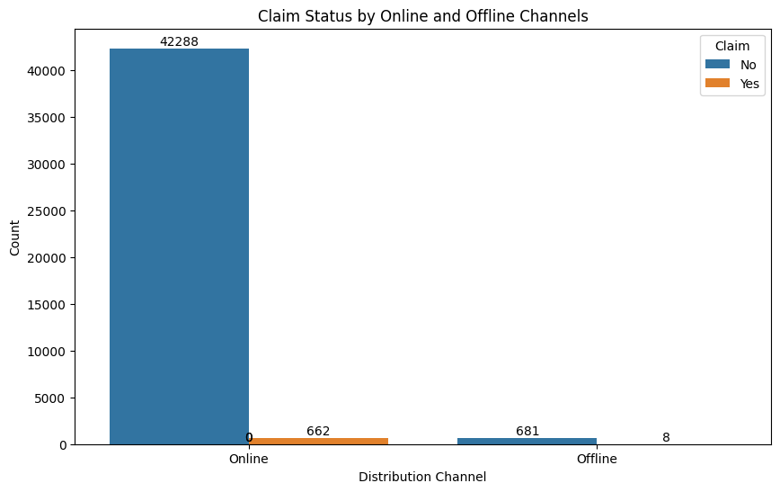
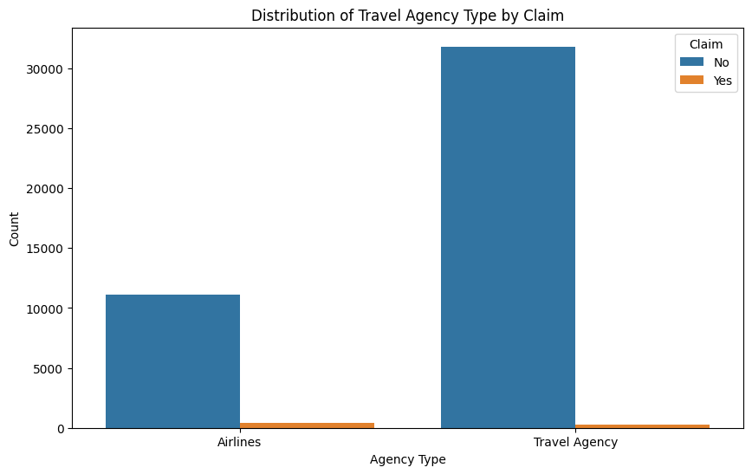
8.72%
8.75%
Duration
Net Sales
DATA ANALYSIS
Capstone 3 : Travel Insurance
OUTLIERS
Ahmadio Rasyadi Hermanu
11%
11.7%
Commision (In Value)
Age

Slide 12
8.72%
8.75%
Duration
Net Sales
DATA ANALYSIS
Capstone 3 : Travel Insurance
OUTLIERS
Ahmadio Rasyadi Hermanu
11%
11.7%
Commision (In Value)
Age

Slide 13
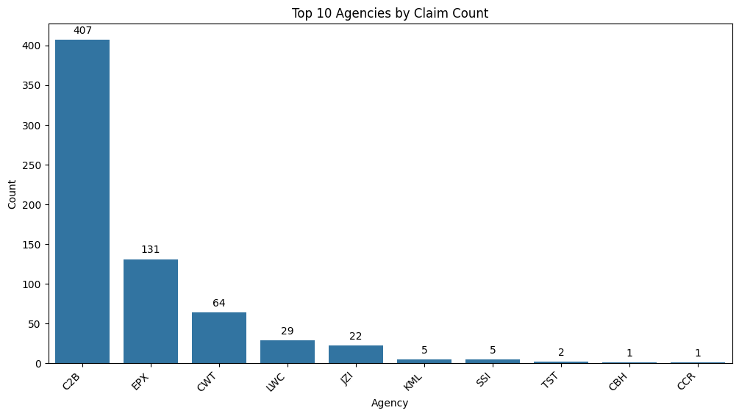
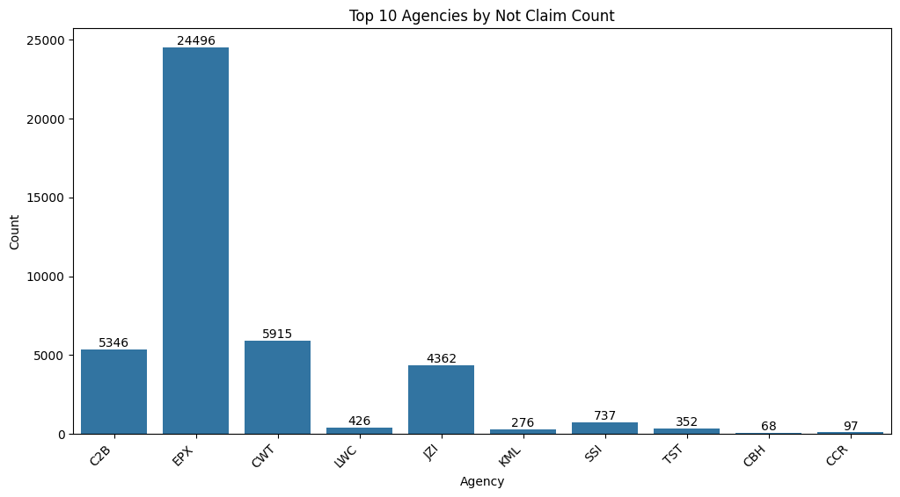
8.72%
8.75%
Duration
Net Sales
DATA ANALYSIS
Capstone 3 : Travel Insurance
OUTLIERS
Ahmadio Rasyadi Hermanu
11%
11.7%
Commision (In Value)
Age

Slide 14
8.72%
8.75%
Duration
Net Sales
DATA ANALYSIS
Capstone 3 : Travel Insurance
OUTLIERS
Ahmadio Rasyadi Hermanu
11%
11.7%
Commision (In Value)
Age

Slide 15
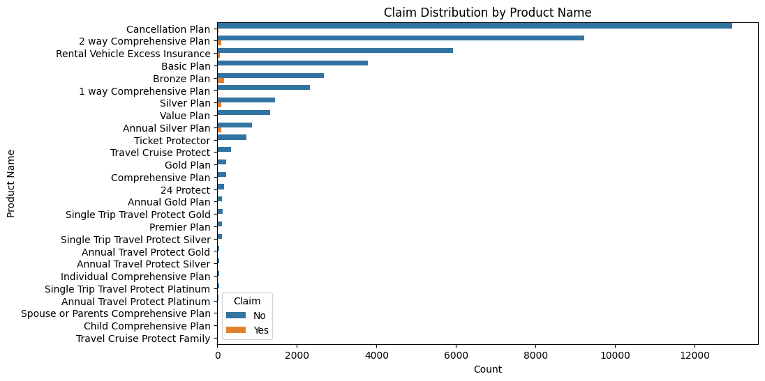
8.72%
8.75%
Duration
Net Sales
DATA ANALYSIS
Capstone 3 : Travel Insurance
OUTLIERS
Ahmadio Rasyadi Hermanu
11%
11.7%
Commision (In Value)
Age

Slide 16
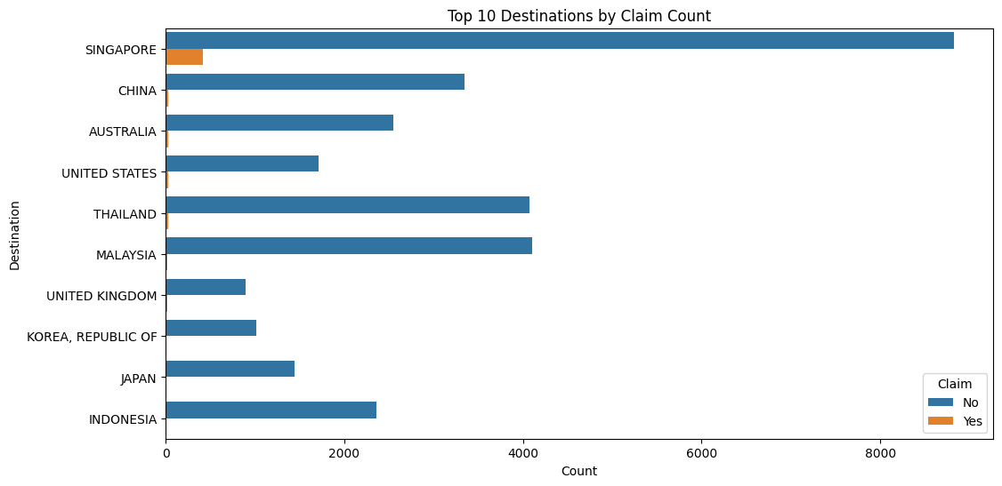
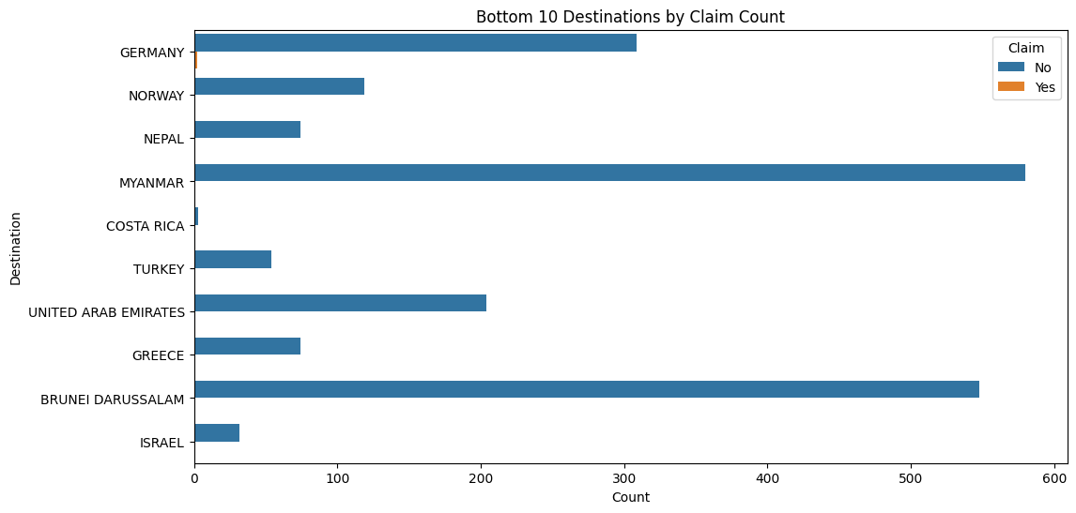
8.72%
8.75%
Duration
Net Sales
DATA ANALYSIS
Capstone 3 : Travel Insurance
OUTLIERS
Ahmadio Rasyadi Hermanu
11%
11.7%
Commision (In Value)
Age

Slide 17
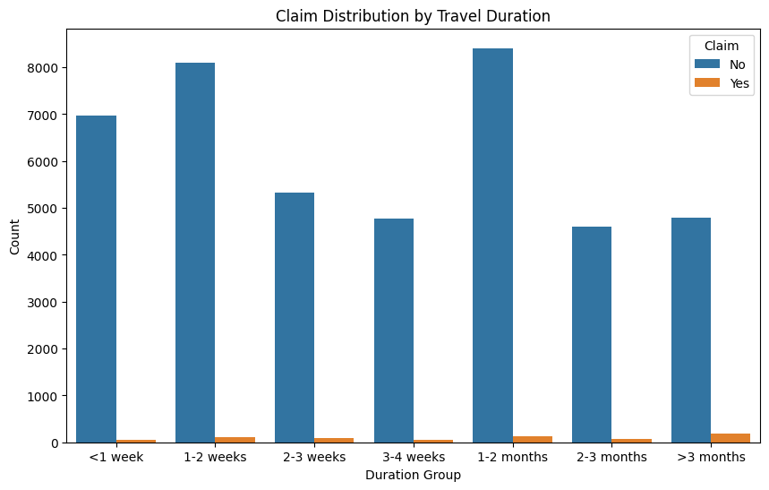
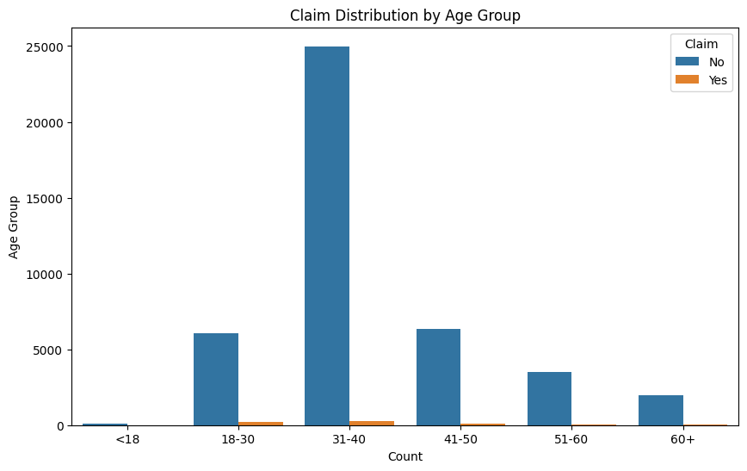
8.72%
8.75%
Duration
Net Sales
DATA ANALYSIS
Capstone 3 : Travel Insurance
OUTLIERS
Ahmadio Rasyadi Hermanu
11%
11.7%
Commision (In Value)
Age

Slide 18
8.72%
8.75%
Duration
Net Sales
DATA ANALYSIS
Capstone 3 : Travel Insurance
OUTLIERS
Ahmadio Rasyadi Hermanu
11%
11.7%
Commision (In Value)
Age

Slide 19
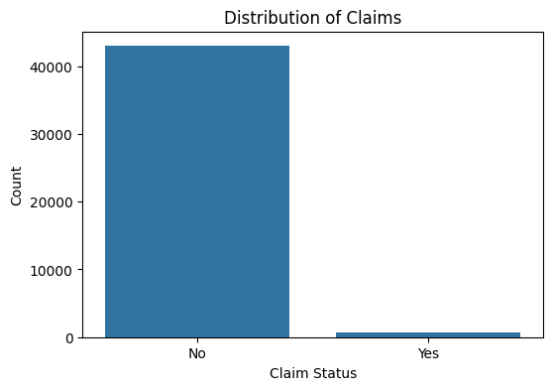
8.72%
8.75%
Duration
Net Sales
Capstone 3 : Travel Insurance
IMBALANCE
DATA
Encoding
OUTLIERS
ONE HOT | Agency Type, Distribution Channel
BINARY | Agency, Product Name, Destination
ORDINAL | AgeGroup, DurationGroup
DATA PREPROCESSING
Ahmadio Rasyadi Hermanu
11%
11.7%
Commision (In Value)
Age

Slide 20
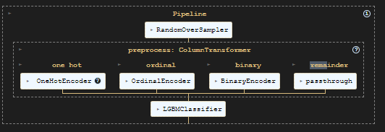
Capstone 3 : Travel Insurance
PIPELINE
OUTLIERS
Logistic Regression
Random Forest Classifier
DATA PREPROCESSING
K-Nearest Neighbor (KNN)
Extreme Gradient Boosting (XGBoost)
Decision Tree
Light Gradient Boosting Machine (LightGBM)
Ahmadio Rasyadi Hermanu

Slide 21
8.72%
8.75%
Duration
Net Sales
Capstone 3 : Travel Insurance
MODEL
OUTLIERS
Logistic Regression
Random Forest Classifier
DATA PREPROCESSING
K-Nearest Neighbor (KNN)
Extreme Gradient Boosting (XGBoost)
Decision Tree
Light Gradient Boosting Machine (LightGBM)
Ahmadio Rasyadi Hermanu
11%
11.7%
Commision (In Value)
Age

Slide 22
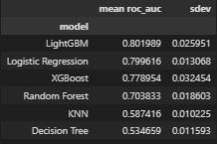
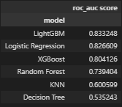
Capstone 3 : Travel Insurance
Model Benchmarking Comparison
OUTLIERS
Logistic Regression
Random Forest Classifier
K-Nearest Neighbor (KNN)
Extreme Gradient Boosting (XGBoost)
K-Fold
Test Data
MODELING
Decision Tree
Light Gradient Boosting Machine (LightGBM)
Ahmadio Rasyadi Hermanu

Slide 23
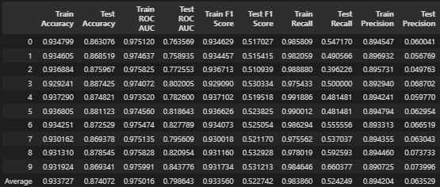
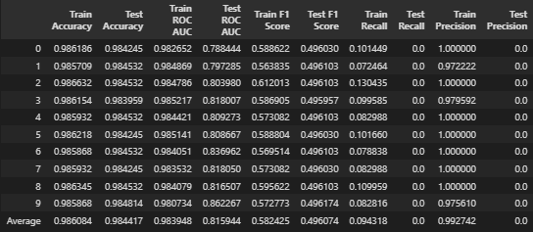
8.72%
8.75%
Duration
Net Sales
Capstone 3 : Travel Insurance
Evaluation Metric Comparison
OUTLIERS
Tidak Dengan
Oversampling
Dengan Oversampling
MODELING
Ahmadio Rasyadi Hermanu
11%
11.7%
Commision (In Value)
Age

Slide 24
8.72%
8.75%
Duration
Net Sales
Capstone 3 : Travel Insurance
Hyperparameter Tuning
OUTLIERS
LightGBM
Default
hyperparam_space = [{
'model__max_bin': [255, 300],
'model__num_leaves': [31, 51],
'model__min_data_in_leaf': [20, 40],
'model__num_iterations': [100, 150],
'model__learning_rate': [0.1, 0.05],
'model__random_state': [42]
}]
default hyperparameter LGBM => `max_bin` = 255, `num_leaves` = 31, `min_data_in_leaf` = 20, `num_iterations` = 100, `learning_rate` = 0.1
Hasil Hyperparameter Tuning
Hyperparameter terbaik LGBM dari hasil Gridsearch => `max_bin` = 300, `num_leaves` = 31, `min_data_in_leaf` = 20, `num_iterations` = 100, `learning_rate` = 0.5
MODELING
Comparison ROC AUC
ROC AUC Score Default LGBM : 0.8232040576730033
ROC AUC Score Tuned LGBM : 0.8543095842639258
Ahmadio Rasyadi Hermanu
11%
11.7%
Commision (In Value)
Age

Slide 25
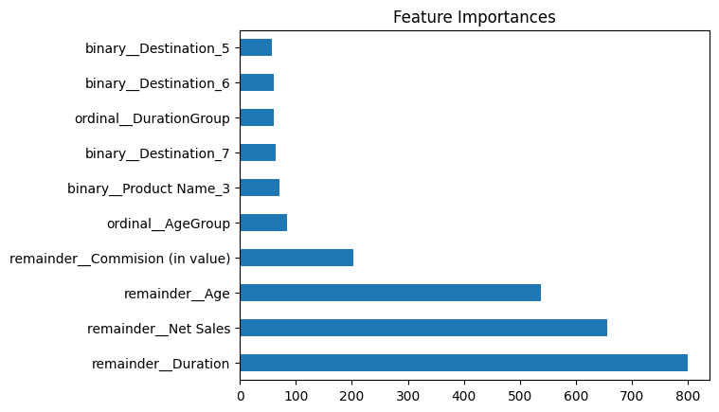
8.72%
8.75%
Duration
Net Sales
Capstone 3 : Travel Insurance
OUTLIERS
Feature Importance
remainder_duration
remainder_net Sales
remainder_age
remainder_commision (in value)
MODEL EVALUATION
Ahmadio Rasyadi Hermanu
11%
11.7%
Commision (In Value)
Age

Slide 26
8.72%
8.75%
Duration
Net Sales
Capstone 3 : Travel Insurance
OUTLIERS
Imbalance Data
Dependence on Feature Quality
Overfitting
Potential for Bias
Model Limitation
Ahmadio Rasyadi Hermanu
11%
11.7%
Commision (In Value)
Age

Slide 27
8.72%
8.75%
Duration
Net Sales
Capstone 3 : Travel Insurance
Masih terdapat ruang untuk perbaikan, terutama dalam menangani ketidakseimbangan data dan meningkatkan kualitas fitur.
Analisis ini mengembangkan model prediktif untuk mengidentifikasi pemegang polis yang kemungkinan besar akan mengajukan klaim asuransi.
perusahaan dapat menyesuaikan produk dan layanan asuransi mereka untuk mengurangi risiko dan meningkatkan kepuasan pelanggan.
OUTLIERS
Model ini memberikan manfaat bisnis yang signifikan dengan memungkinkan perusahaan untuk mengalokasikan sumber daya secara lebih efisien kepada pelanggan yang dianggap berisiko tinggi.
hasil dari model ini juga dapat digunakan untuk mengoptimalkan penetapan harga premi, sehingga menciptakan keseimbangan antara risiko dan profitabilitas.
Conclusion
Ahmadio Rasyadi Hermanu
11%
11.7%
Commision (In Value)
Age

Slide 28
Capstone 3 : Travel Insurance
OUTLIERS
Atasi Ketidakseimbangan Data
Integrasi dengan Bisnis
Tingkatkan Feature Engineering
Strategi Pemasaran dan Layanan Pelanggan
Mitigasi Bias
Optimalisasi Penetapan Harga
Recommendation
Ahmadio Rasyadi Hermanu

Slide 29
OUTLIERS
TERIMA KASIH
Capstone 3 : Travel Insurance
Ahmadio Rasyadi Hermanu

